Slide 1
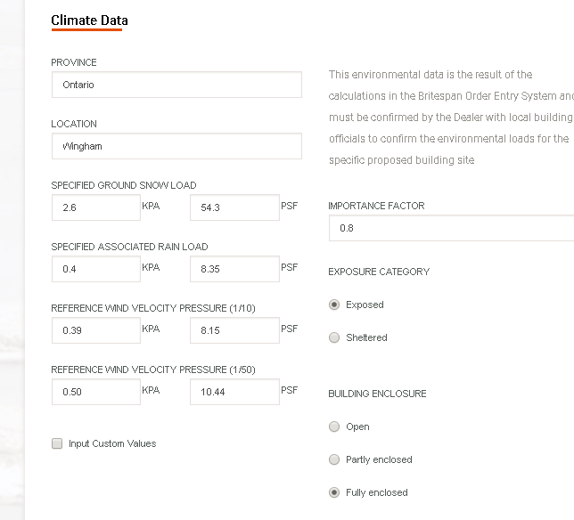
OES Snag Report – Snow & Rain Values on Reactions
23.July.2018
This is the correct Snow load for Wingham ON
This is the correct Rain load for Wingham ON
Page 1 of 3

Slide 2
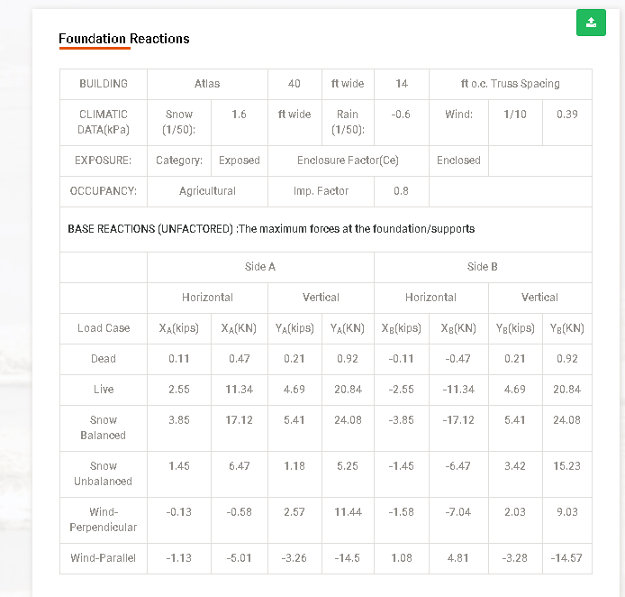
OES Snag Report – Snow & Rain Values on Reactions
23.July.2018
Why did the snow load change to 1.6 kPa?
It returned 2.6 (correct) 2 pages previously….
Why did the rain load change to -0.6 kPa?
It returned 0.4 (correct) 2 pages previously….
Page 2 of 3

Slide 3
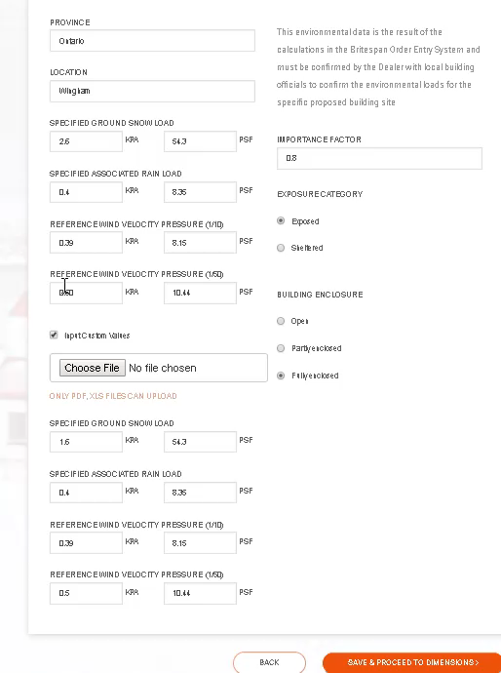
OES Snag Report – Snow & Rain Values on Reactions
23.July.2018
Page 3 of 3

